Slide 1
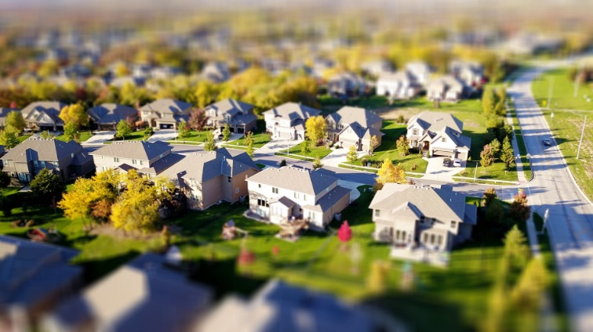
Factors Driving Home Prices Manju Sankaranarayanan
http://www.free-powerpoint-templates-design.com

Slide 2
Project Brief
Investors are essentially lending money to home buyers in mortgage-backed securities. So its important how to allocate dollars earmarked for investment into mortgage-backed securities.
Its necessary to look into the factors that drive home prices.
For this analysis, the data set was a sample of 1460 houses in Ames, Iowa that were sold between 2006-2010
Kaggle Data Set: https://www.kaggle.com/c/house-prices-advanced-regression-techniques/data

Slide 3

What drives Home Prices?
.
Some of the factors that drive home prices are:
Demographics
Interest Rates
Economy
Government Policies/ Subsidies.
In addition, qualities of the home and property have a big impact on prices.
I hypothesized that some of the biggest driving factors would be:
1. Overall Quality
2. Garage Cars
3. Year Built and Remodel added
4. Living Area
5. Total Basement SF
6. Kitchen Quality
7. Neighborhoods

Slide 4
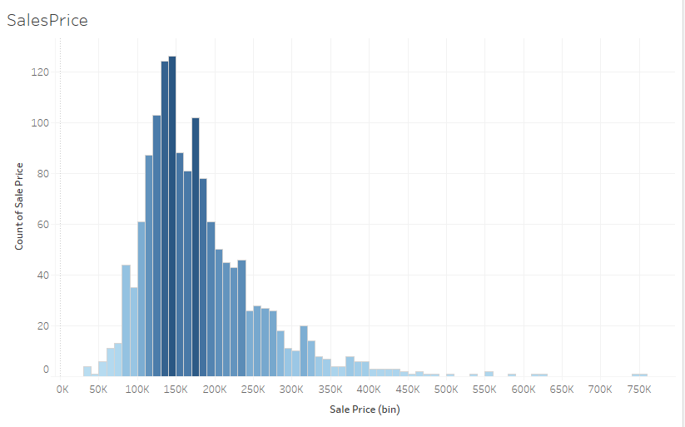
Sales Price Histogram
Sum of Sales : $264,144,946
Avg. of Sales: $180,921
Max. of Sales Price: $755,000
Min. of Sales Price: $34,900
Total Count of Sales : 1460
Bias test was performed and found that with 95% confidence, the Sales data is randomly distributed..

Slide 5
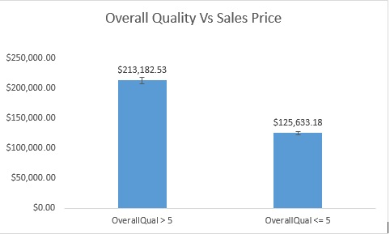
Overall Quality
Overall Quality of the house is taken into consideration and was rated from 1 to 10.
Correlation : 0.790982
T-tests: H0: p = 0, H1: P < .05
Quality score >=5 vs. <5:
P < .05 at 5.92E-145

Slide 6
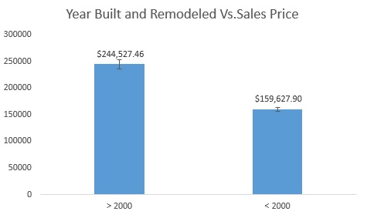
Year Built/ Remodeled
Houses built and/ or remodeled before and after the year 2000 is taken
T-tests: H0: p = 0, H1: P < .05
Year Built score >=2000 vs. <2000:
P < .05 at 1.471E-53
The more recent the house was built or remodeled, the higher is the Sales Price

Slide 7
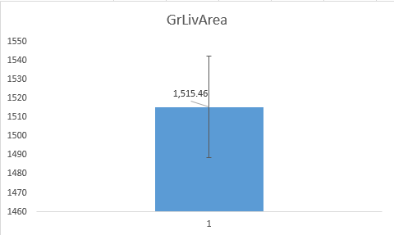
Living Area
Living Area Sq.Ft of the house is taken into consideration. T- test was performed to check if the sample mean was different from the population mean.
Correlation : 0.708624
T-tests: H0: p = 0, H1: P < .05
The sample mean of 1515 is not significantly different than 1500 at p = .261.

Slide 8
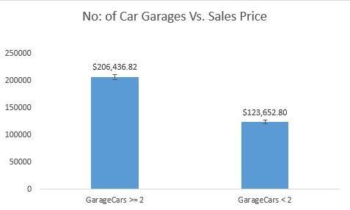
Garage Cars
Houses built and/ or remodeled before and after the year 2000 is taken
T-tests: H0: p = 0, H1: P < .05
Garage score >=2 vs. <2:
P < .05 at 1.797E-137
The more number of Car Garages, the higher is the Sales Price.

Slide 9

Total Basement Sq.Ft
Total Basement Sq.Ft over 200f the house is taken
T-tests: H0: p = 0, H1: P < .05
Bsmt. Sqft score >=1500 vs. <1500:
P < .05 at 9.853E-39
The higher the Total Sq.Ft of the Basement, the higher is the Sales Price.

Slide 10
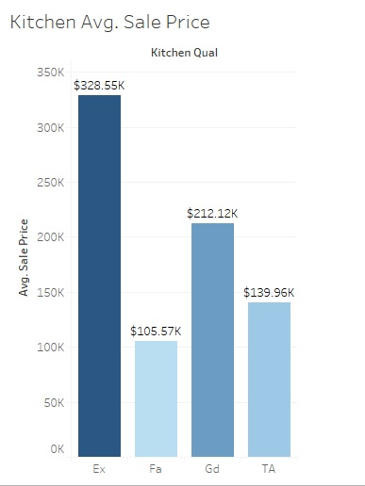
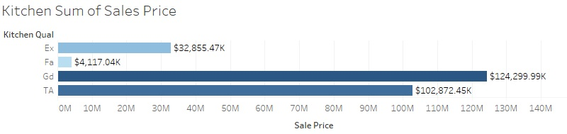
Kitchen Quality
Houses with Excellent rated Kitchen Quality has highest Avg. Sales Price of 329K
Largest Sum of Houses have Good or Average Kitchen Quality.

Slide 11
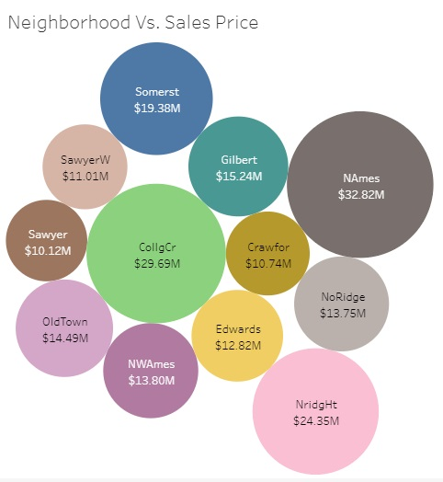
Neighborhood
The chart indicates the Top 10 and the Bottom 10 Neighborhoods with respect to the Sales Price.
NAmes has the highest sum of Sales Price of $32.8 M.
Blueste has the lowest sum of Sales Price of $275,000.
.

Slide 12
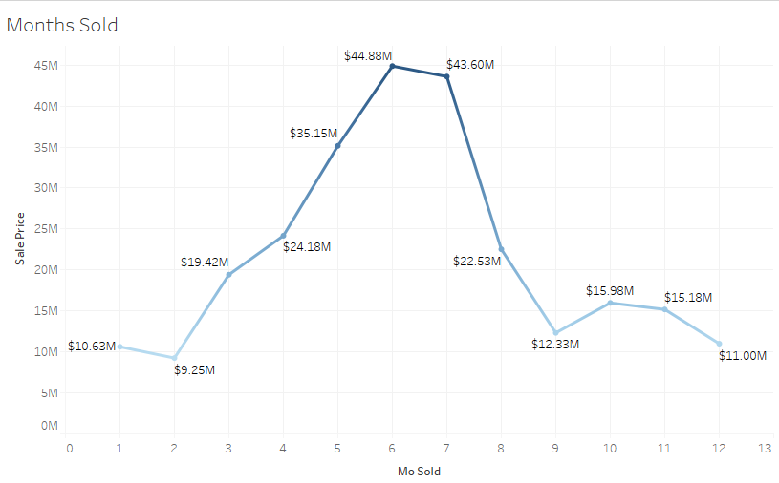
Months Sold
As you can see from the Graph, the highest number of properties sold are in the months of June and July.

Slide 13
Conclusion
Some of the factors that drive home prices are:
Overall Quality
Living Area
Total Basement Sq.ft
Number of Car Garages
Year Built/ Remodeled
All the above factors had a positive correlation when compared to the Sales Price.
Some of the other factors include Kitchen Quality, Neighborhoods and also the month.

